Slide 1
United States Department of Agriculture (USDA) -
Animal and Plant Health Inspection Service (APHIS) -
Wildlife Services (WS)
Brian Bjorklund, Wildlife/Rabies Biologist
Ryan Bevilacqua, Wildlife/Rabies Technician
Cape & Islands Health Agents Coalition Meeting
October 20, 2017
Notes:
WS is a program within the U.S. Department of Agriculture’s Animal and Plant Health Inspection Service (APHIS) that provides Federal leadership and expertise to resolve wildlife conflicts and create a balance that allows people and wildlife to coexist.

Slide 2
USDA-APHIS-WS MA/CT/RI Program:
A federal, non-regulatory, cooperative program providing research-backed technical expertise and specialized wildlife control equipment, operating in compliance with all Federal, State, and local laws for resolution of wildlife conflicts with people.
Provide free site visits and technical consultation as well as providing assistance when necessary to obtain Federal/State depredation permits.

Slide 3
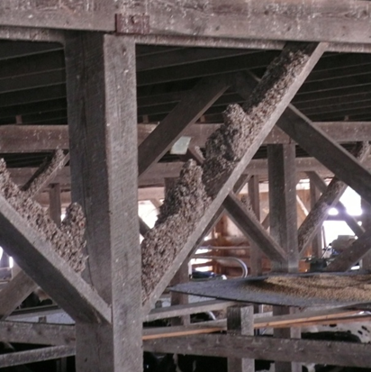
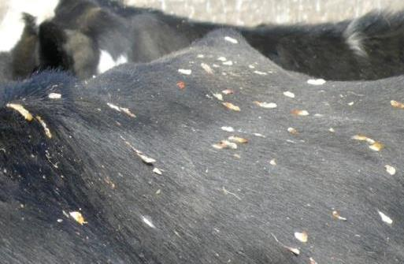
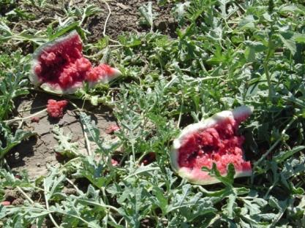
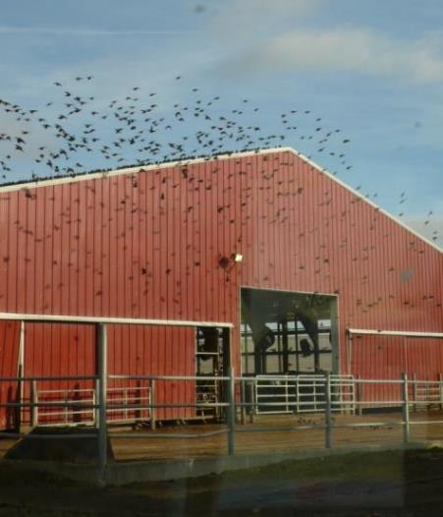
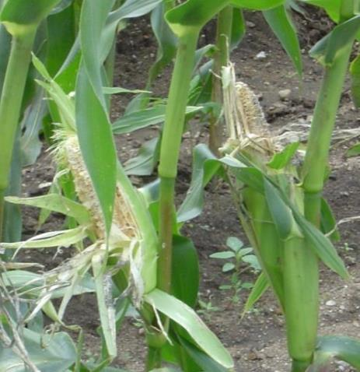
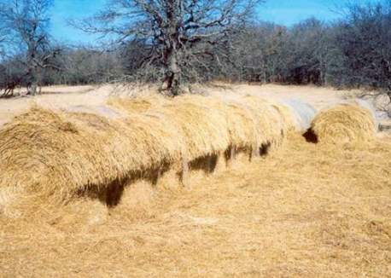
WS’ Role towards Wildlife Conflict Management Includes:
Protecting Agriculture

Slide 4
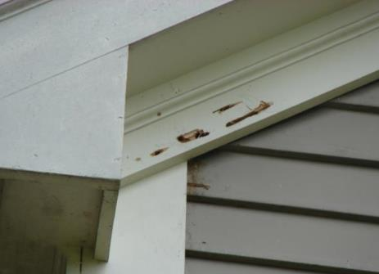
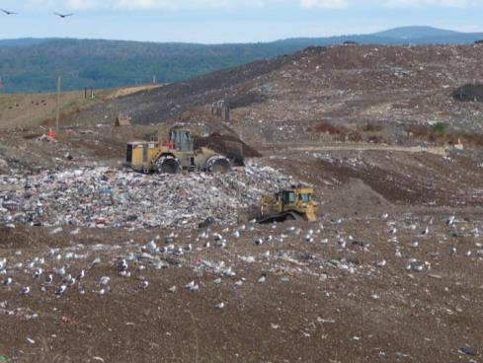
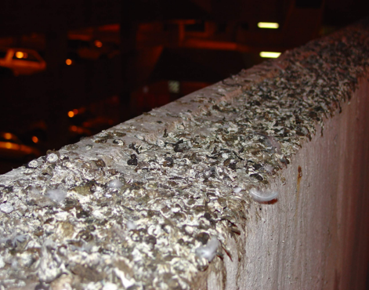
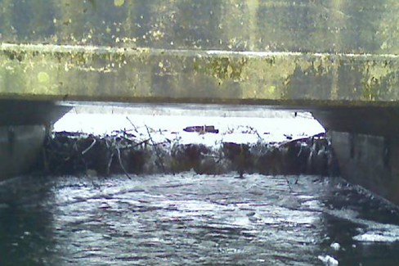
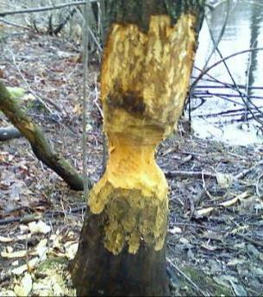
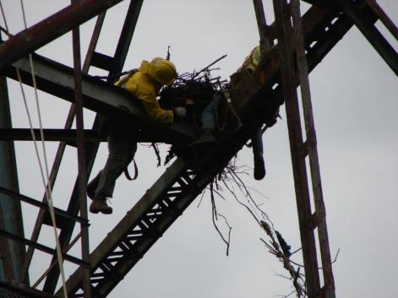
Protecting Property

Slide 5
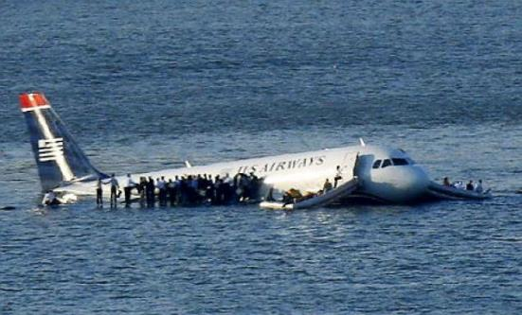
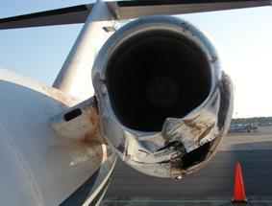
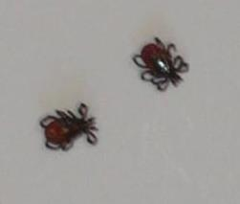
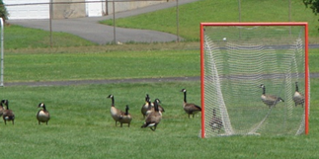
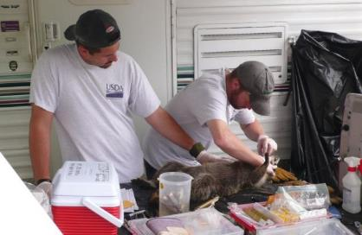
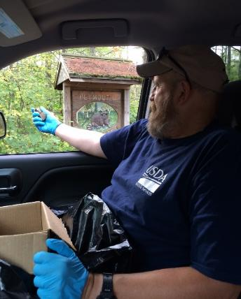
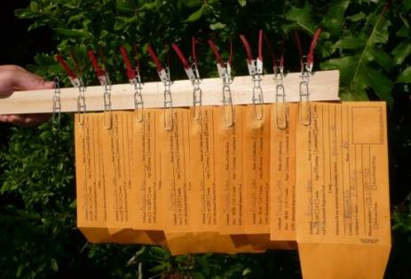
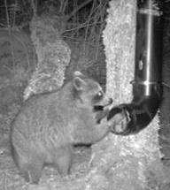
Protecting Human
Health & Safety
Notes:
Federal leadership and expertise include protecting livestock and poultry, natural resources, and public health and safety through an integrated wildlife management approach.

Slide 6
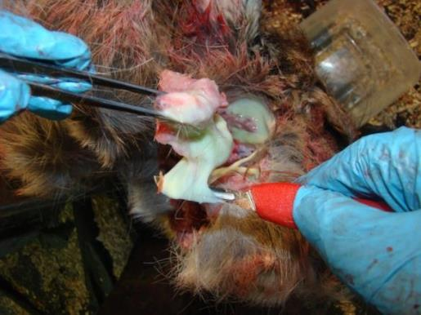
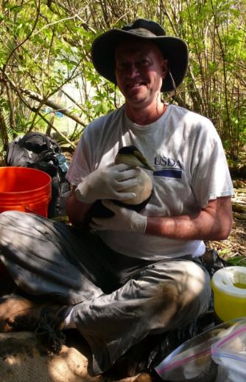
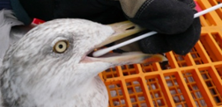
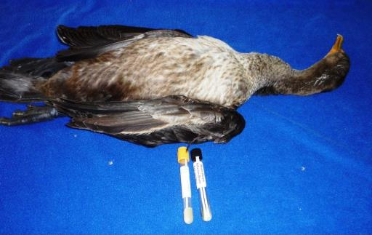
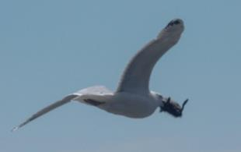
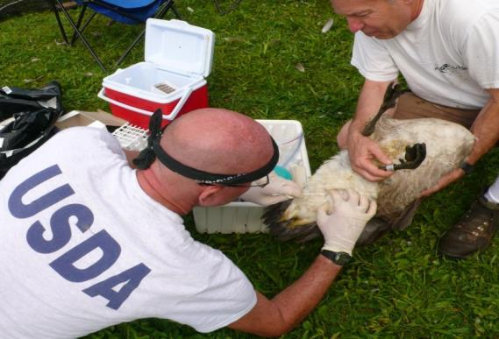

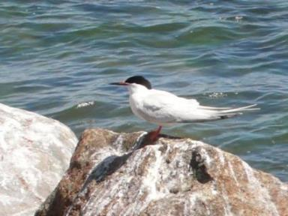
Protecting Wildlife.
Notes:
WS works in every state to prevent and control the transmission of wildlife-borne diseases by providing assistance to federal and state agencies, tribes, and other entities. Assistance with wildlife-borne disease surveillance, prevention, and eradication is managed through the Wildlife Disease Surveillance and Emergency Response Program (NWDP) and Rabies Management Program. The NWDP is responsible for surveillance, monitoring, and response to wildlife disease events, while the National Rabies Management Program works similarly with rabies.

Slide 7
USDA-APHIS-WS MA/CT/RI Program:
A staff of 19, including wildlife biologists, wildlife technicians, and office personnel.
Includes 2 airport wildlife biologists.
1 wildlife disease biologist (vacant) & 1 wildlife rabies biologist.
State office in Amherst, MA and a field office in Sutton, MA.

Slide 8
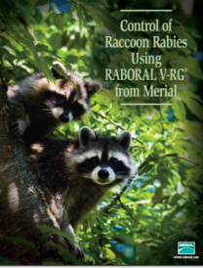


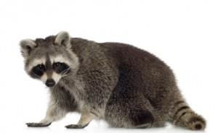
Management with Raboral V-RG® ORV in U.S.
Raboral V-RG® is the only licensed ORV in the U.S.
>153 million V-RG baits distributed in U.S. since 1992
Coordinated ORV with V-RG has resulted in 3 major accomplishments in the U.S.
Notes:
Raboral V-RG distributed since 1992 in 19 states (and placebo version in Puerto Rico), targeting raccoons, coyotes, gray foxes, skunks, feral dogs, and mongooses (PR).

Slide 9
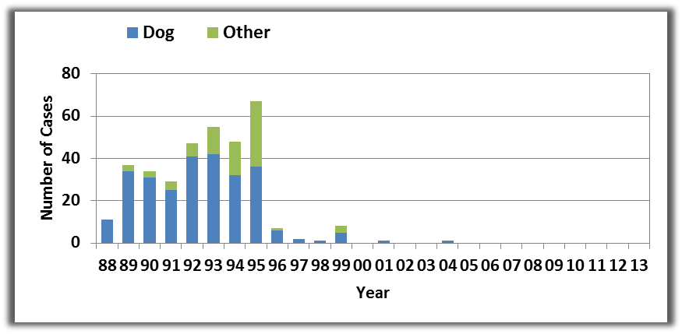

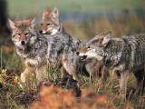
Cooperative Rabies Management Program Accomplishments
No canine rabies in U.S. since 2004, declared free in 2007
One gray fox rabies case in Texas since May 2009
No appreciable spread of raccoon rabies to the West
Also: No cases of bat-like virus in gray foxes near Flagstaff, AZ
Also: Conducted broad scale ONRAB Field Trials in 5 states (2011-2014)
Dog-Coyote Variant

Slide 10


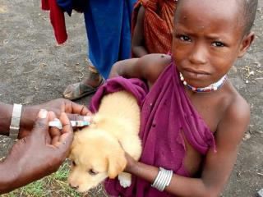
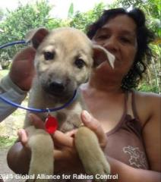
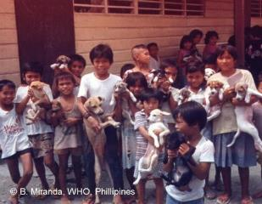
Global Rabies Statistics
Occurs in >150 countries and territories
>70,000 people die each year worldwide from rabies
>20 million people receive rabies prophylaxis annually
Global rabies burden >$6 billion annually
Hotspots: Africa and Asia (dogs = 90% of exposures)

Slide 11

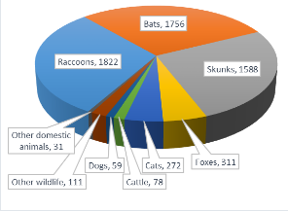
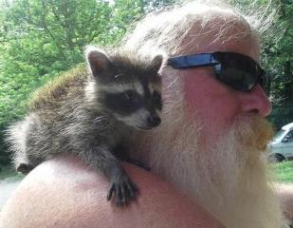
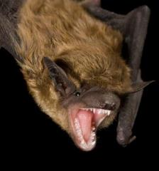
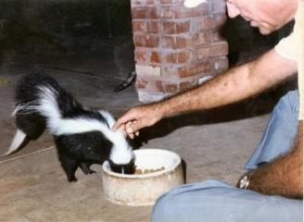
U.S. Rabies Statistics (2014)
6,033 rabies cases (incl. 1 human)
93% of rabies cases were in wildlife
Up to 40,000 people exposed per year
>$300 million annually
Notes:
49 states and Puerto Rico reported 6,163 rabies cases including 1 human to the CDC. Man bitten by bat and developed symptoms in Iraq and died in Switzerland. First report of rabies acquired in the US with symptoms development, medical management, and diagnosis abroad.
Up to 40,000 people exposed to potentially rabid animals in the U.S. each year.
92 of every 100 reported cases of rabies are in wild animals in the U.S.

Slide 12
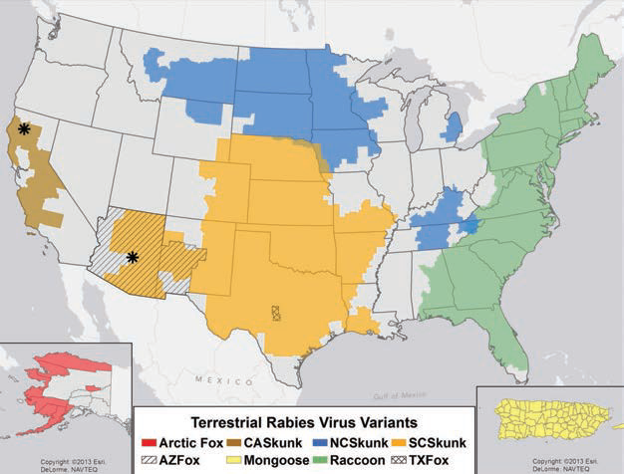

Terrestrial Rabies Virus Variants 2013
skunk
fox
raccoon
skunk
Variants adapted to specific reservoir species
Found in broad geographic regions
8 terrestrial variants & 2 potential host shift events.
fox
fox
fox
fox
mongoose

Slide 13
Spread of Raccoon Rabies
1953-2007
Raccoon Rabies Translocation 1977
2004-2007
1999-2003
1994-1998
1990-1993
1985-1989
1977-1984
1973-1976
1968-1972
1963-1967
1958-1962
1953-1957
Notes:
The accelerated spread of raccoon rabies (~35 miles/year) that was jump-started by the translocation of raccoon rabies to the WV-VA border in the late 1970’s, provided much of the early inertia for use of ORV in the US as an adjunct to conventional rabies prevention and control.

Slide 14
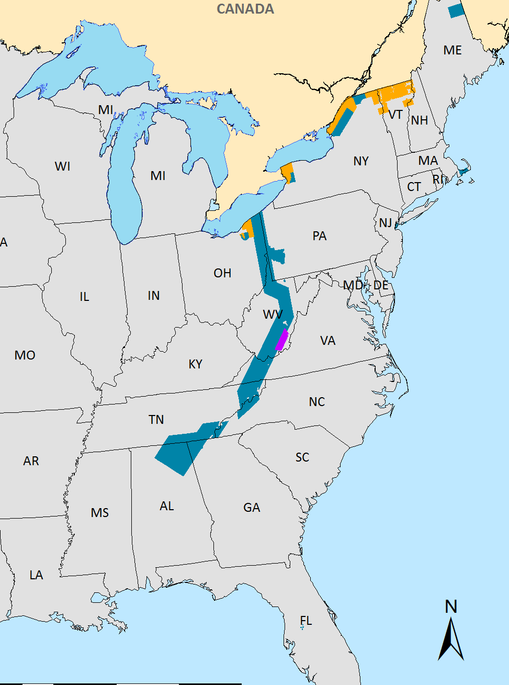


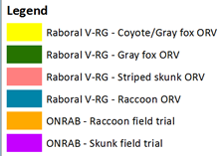



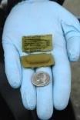
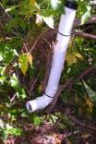
Current ORV Distribution in the U.S. (2014)
Baits Distributed: 8,198,991
Distance Flown: 274,167 km
Area baited: 162,902 km²
Hours of Flight: 1,133
Across 15 States
Notes:
All ORV on map is from CY2014 and surveillance is CY13 and CY14 (through 10/15/14) combined.
8,198,991 = 6,505,631 V-RG and 1,693,360 ONRAB
6.5 million VRG baits (79%)
1.7 million ONRAB baits (21%)

Slide 15
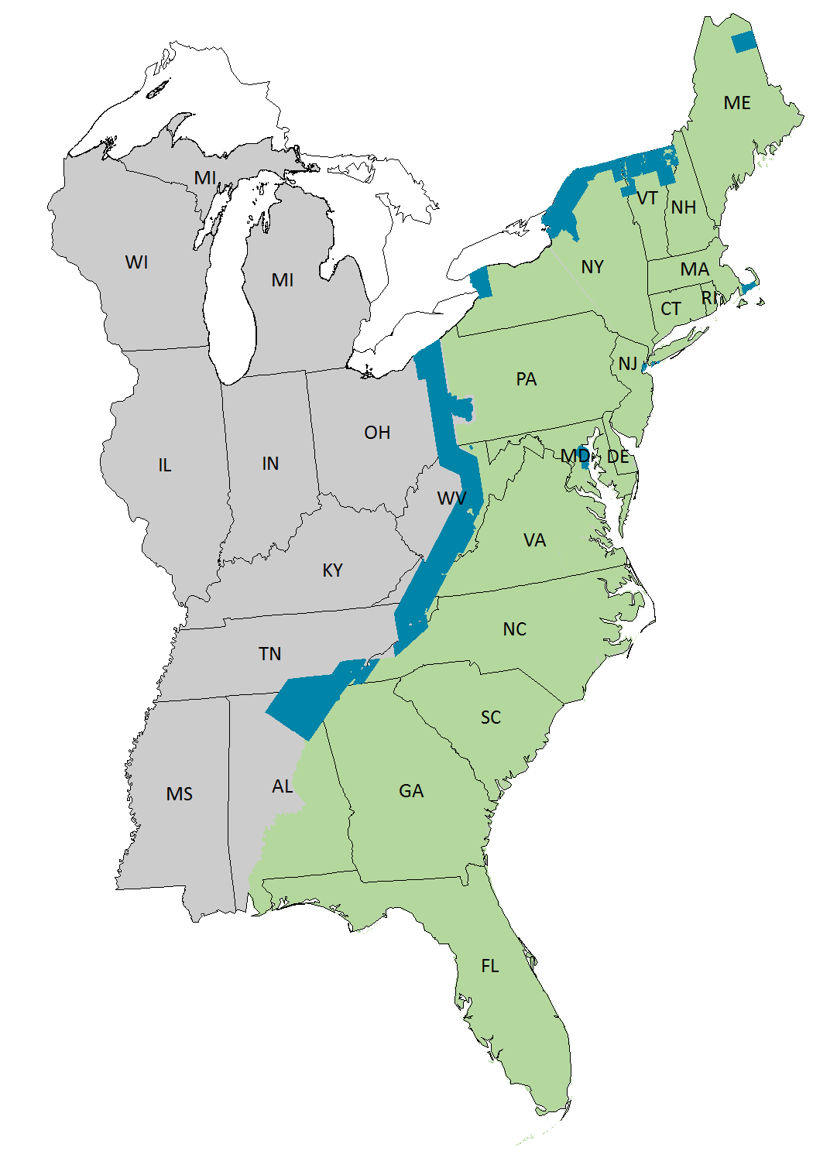
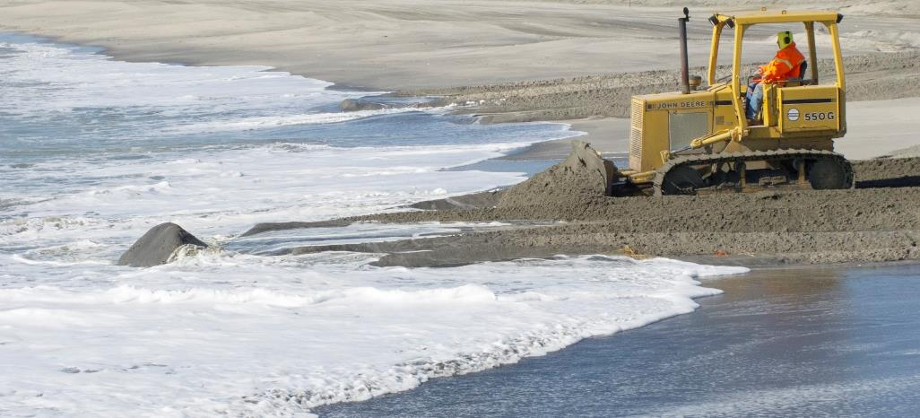



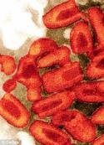


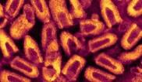


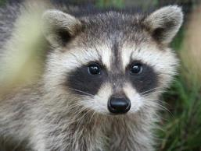
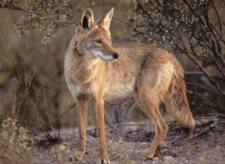
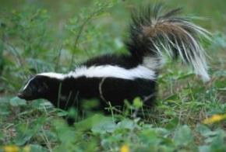


Program Focus on the Goal of Pushing Raccoon Rabies to the Atlantic Ocean
Oral Rabies
Vaccination
Elimination
through strategic
management
“Raccoon rabies free by 2043 (2047?)”

Slide 16


Massachusetts Rabies Epizootic and ORV History
September 1992
MA index case
ORV Zone
1994-2003
CAPE COD OR BUST
Cape Cod Canal
Notes:
Rabies was first detected in MA in September, 1992 in the small town of Ashby. As a response to this in 1994, an Oral Rabies Vaccination zone was established in southeastern, MA to prevent the spread of the disease on to Cape Cod. The Cape Cod Canal acted as a barrier for ten years.

Slide 17

Cape Cod Canal
Notes:
Cape Cod Canal

Slide 18


Cape Cod, Massachusetts
2001 – MA WS began cooperation on ORV program (ORV program began in 1994)
Goals were to prevent spread of raccoon rabies to Cape Cod
Canal barrier breach in 2004
Rabies reaches Provincetown by 2006
2006-2008 – Initial bait station studies
2011-2013 – Collaboration with MA WS on numerous bait station research projects
Notes:
The Cape Cod Oral Rabies Vaccination program is among the longest running ORV programs in the nation, beginning in 1994 as a cooperative venture between Tufts University, Mass Department of Public Health, and Centers for Disease Control and Prevention.
Like many ORV programs, the Cape Cod program has utilized a strategy of creating barriers that utilized landscape features to strengthen the buffering effect.
In this case, the 28 km long by 143 meter wide Cape Cod Canal can certainly be assumed to have helped prevent the spread of rabies on to Cape Cod for 10 years.
After a rabid raccoon was discovered on the east side of the Canal in March 2004, emergency TVR, ORV, and enhanced surveillance was implemented.
Unfortunately, despite ORV twice per year, raccoon rabies had spread to Provincetown by 2006.
Use of ORV bait stations began experimentally in 2006, and were operationally-implemented in 2009. I’ll discuss this in further detail in a few moments

Slide 19















Cape Cod Oral Rabies Vaccination Program (CCORVP) Cooperators
Local Police, Natural Resources, Animal Control, Health, DPW, and Highway Departments
USDA - APHIS - Wildlife Services, Plant Protection and Quarantine, and Veterinary Services
Barnstable County Department of Health and Environment
MA Department of Public Health
Centers for Disease Control and Prevention
Tufts Cummings School of Veterinary Medicine
MA Division of Fisheries and Wildlife
The Mashpee Wampanoag Tribe
Cape Wildlife Center
Massachusetts National Guard
US Coast Guard
Trustees of Reservations
Land and Conservation Trusts of Southeast MA
Plymouth County Sheriff’s Department
Senior Environment Corps/Elder Services
AmeriCorps
United States Fish and Wildlife Service
MA Department of Conservation and Recreation
National Oceanic and Atmospheric Administration
Veterinary Associates of Cape Cod
MA Department of Transportation
Mass Audubon
4-H Club Farley
New England Wildlife Center
MA Environmental Police
National Park Service
MA State Police
US Army Corps of Engineers
Nuisance Wildlife Control Operators
Citizens and Businesses of Southeast MA
Notes:
This slide is a testament to how successful we’ve been as a program. We’ve had an enormous amount of cooperation and support since it’s inception. The Cape Cod ORV Program could not have had the success that we have without the help of each and every one these players!

Slide 20


Oral Rabies Vaccination (ORV) Bait Formats

Slide 21


ORV Bait Stations
ORV bait stations
  Cornell in Buffalo, NY (research); Long Island (operational)
  WS in Massachusetts since 2006
MA adapted
bait station design
NY bait station design
Notes:
Cornell University began the ORV bait station-related research in Buffalo and instituted the operational use of stations on Long Island, New York. On Cape Cod, WS began the experimental use of bait stations in 2006 in the suburban-resort community of South Yarmouth. The use of bait stations on the Cape was expanded in 2009 and have been an integral part of the ORV program there ever since. Over time, the design developed by Cornell (left) evolved to the design shown here on the right. The new design is camouflaged to prevent theft and materials deemed not necessary were eliminated and replaced as a cost-savings measure.

Slide 22


ORV Bait Stations
Spring 2009 – 104 stations
Fall 2009 & Spring 2010 – 116 stations
Notes:
During the 2009 –Spring 2010 ORV, coated sachet baits were hand-distributed on the outer-Cape and the northern portions of the mid-Cape. As a measure to get bait to target animals more effectively and to avoid human or pet contact, 116 bait stations were deployed at high and low densities from Yarmouth to Orleans based on habitat types.

Slide 23

ORV Bait Stations
195 bait stations
Notes:
After several discussions with cooperators, the Fall 2010 ORV marked the start of the move back towards the Cape Cod Canal. Raccoon rabies was last detected from Yarmouth through Provincetown in 2008 or prior. Funding that had been used to bait the outer-Cape towns was reallocated to include Barnstable in the ORV zone.

Slide 24

ORV Bait Stations
238-242 bait stations
Notes:
Here is a closer look at our ORV zones from this past fall. We used 238 bait stations, distributed between the low and high density areas. 4 additional stations will be added to the zone for the upcoming Spring ORV, and zones will remain the same. Baiting is scheduled to begin the week of April 28 and will wrap up by May 28.

Slide 25

CCORV Rabies Surveillance
Passive public health surveillance
-Human exposure
-Pet/livestock exposure
Enhanced rabies surveillance
-Roadkills
-Nuisance wildlife
-Euthanasia of sick-acting wildlife
-Deceased wildlife
Notes:
Based primarily on human and pet exposure events, passive public health surveillance is generally not sufficient for characterizing rabies epizootics in wildlife.
Enhanced rabies surveillance is specifically directed at detecting the presence of rabies and may include sampling sick or strange-acting animals, roadkills, and animals removed for wildlife damage control purposes.

Slide 26

Cape Cod Rabies Surveillance (2002 - 2015)
Year | # Positives
2002 | 0
2003 | 0
2004 | 124
2005 | 157
2006 | 74
2007 | 5
2008 | 10
2009 | 8
2010 | 11
2011 | 7
2012 | 4
2013 | 2
2014 | 0
2015 | 3 (all mainland)
Notes:
As you all know, public health surveillance only examines those animals that have been involved with a potential human or pet exposure. Enhanced surveillance allows us to get a better idea on what the current status of the rabies virus is on Cape Cod. The majority of these animals would not have been tested if we were just operating on a public health surveillance scheme. This map shows rabies surveillance efforts on Cape Cod since 2002 through last year.

Slide 27


Cape Cod Raccoon Rabies Cases (2002 – 2016)
East of Cape Cod Canal

Slide 28

ORV Bait Stations
319 bait stations
Notes:
As a result of encouraging rabies surveillance and high vaccination rates, we decided it was time to shift the ORV zone back to the canal last fall. Here is a closer look at our current ORV zones. We utilized 319 ORV bait stations, distributed between the low and high density areas. The areas marked here in green were hand-baited by town and county officials, volunteers, and USDA.

Slide 29


Slide 30

Cape Cod ORV Zone (2017)
Cape Cod bait distribution:
-19,120 FMP baits
  -14,580 FMP baits in 243 bait stations
  -18,000 CS baits in hand-baiting zone
Mainland bait distribution:
-72,000 FMP baits
  -69,120 FMP baits in hand-baiting zone
  -2,448 FMP baits in 48 bait stations

Slide 31

Cape Cod Enhanced Rabies Surveillance
NON-EXPOSURE specimens wanted from all Cape Cod towns and Wareham, Plymouth, Carver, Middleboro, Rochester, Marion, & Kingston
Raccoons, skunks, foxes, coyotes, fishers, river otters, woodchucks, and sick-acting opossums
Roadkills, animals deceased in yards, euthanized animals, etc.
Please call (413) 537-9394
If you are unable obtain the animal, let us know and we can arrange pick-up
Please bag and tag animal – provide date, address, and species on the tag

Slide 32


Cape Cod Enhanced Rabies Surveillance

Slide 33

Cape Cod Enhanced Rabies Surveillance
Raccoon – October 20, 2017
Barnstable County Complex – Old Jail
Brian Bjorklund – 413-537-9394
P

Slide 34

Notes:
This map shows the distribution of rabies surveillance freezers throughout the Cape.

Slide 35

Enhanced Rabies Surveillance
2012-present

Slide 36









Outreach
Notes:
Prior to each ORV bait distribution, we conduct media events to get the word out about the program. This is especially important when moving the zone in to new areas or areas where baiting has not occurred in several years.
Informational materials are sent out to all area cooperators via email including a FAQ sheet, ORV Poster, and a Slide for local TV channels.
In addition to the media event, the Cape Cod Rabies Task Force issues a Press Release to alert the public of the activity.
Enjoyed an immense amount of local support over the years

Slide 37


Outreach
Informational material sent to cooperators
  FAQs
  ORV Poster
  Maps for each baiting zone
  Slide for TV Stations
Media event held prior to each baiting event
  Newspapers, radio, etc…
CCRTF Press Release

Slide 38




Outreach
Rehang ORV flyers throughout Mainland ORV zones in effort to inform public about the program and reduce bait contacts – QR code
Postings on public access TV stations and websites
CCRTF Facebook page and memes for the Cape Cod Rabies Task Force
Notes:
WB Bjorklund and SD Chandler attended RITA in Fort Collins, CO (October 4-9); both gave oral presentations
WB Bjorklund and WDB Mickley gave a presentation at the Northeast Chapter of The Wildlife Society in Westborough, MA (April 16); interactive demonstrations of equipment followed (assisted by WT Bevilacqua and WB Rogers)
CCORV Media Events (April 8 and September 17)
Public Access TV segment filmed (On the Road with David Vieira [State Rep.] – September 29, October 15, and one date in December)

Slide 39


Outreach
Social media to serve critical role in getting information out to public
Utilization of department or organization’s social media accounts
USDA to provide additional documents that can be uploaded and shared easily
Share with:
Local vet clinics and hospitals
Dog walking groups
Hunting clubs
Any others!

Slide 40



Outreach
https://www.facebook.com/CapeCodRabiesTaskForce/

Slide 41



Post-ORV Sampling
Traditional NRMP samples: blood for serology, tooth for biomarker screening
Hand-vaccinated against rabies
Ear-tagged for identification if encountered in the future
Notes:
As you all know, we’ve conduct numerous raccoon density estimation studies on Cape Cod (and within other rabies ORV zones in the country). These studies allow us to obtain critical population data that may be used when making decisions on bait distribution and other management activities. We also collect samples from these specimens that can be used to access the effectiveness of our ORV program.

Slide 42


Post-ORV Sampling
In addition to traditional NRMP samples, WS has collected raccoon DNA samples as part of collaborative project with the National Wildlife Research Center
  Examine population makeup on mainland Barnstable County, eastern-most peninsular Barnstable County, and further down the Cape.
  Blood (Whatman Cards), brainstem (negative DRIT samples), or tissue samples (ear tips from deceased animals)
Notes:
In addition to traditional NRMP samples, WS is collecting raccoon DNA samples as part of collaborative project with NWRC
Examine population makeup on mainland Barnstable County, eastern-most peninsular Barnstable County, and further down the Cape.
Blood (Whatman Cards), brainstem (negative DRIT samples), or tissue samples (ear tips from deceased animals)

Slide 43



Conclusions
Build and enhance cooperative relationships with new partners and townships
Maintain enhanced rabies surveillance Cape-wide and on the mainland
Continue bait station research
Five-year goal of elimination of raccoon rabies from Cape Cod and the establishment of mainland barrier

Slide 44




Wildlife Disease Sampling
U.S. Department of Agriculture
Animal and Plant Health Inspection Service
Wildlife Services
National Wildlife Disease Program
Notes:
44

Slide 45



USDA-APHIS-WS
Disease Surveillance Projects
  Wellfleet Bay Virus
  Avian Influenza & Health
  Feral Swine Diseases
  Plague & Tularemia
  Leptospirosis

Slide 46


Purpose of Sampling
Monitor or conduct surveillance for endemic disease
Protect American agriculture, human health & wildlife
Serve as Early Detection System for foreign animal diseases

Slide 47



Avian Influenza
Purpose
  Early detection of HPAI
Primary Target Species
  Waterfowl (Order Anseriformes)
  Geese (Order Anseriformes)
  Shorebirds (Order Charadriiformes)

Slide 48



Collection Strategies
Live Wild Bird
Hunter Harvest
Morbidity/Mortality Event
Sentinel Species
Environmental
Notes:
Emphasis on morbidity/mortality events
Environmental samp
48

Slide 49



Avian Influenza
Sample type
  Wild Bird – oropharyngeal & cloacal, tracheal
  Environmental – fecal
Diagnostic Tests
  PCR
  Virus isolation

Slide 50

AI Sampling in MA & CT
Connecticut River Watershed
  Target goal- 270
Connecticut Coastal
  Target goal- 380
Sampling Period
  May-Aug
  Aug-Dec
  Dec-Feb

Slide 51

Common Eider (Somateria mollissima)
Photo Courtesy Andreas Trepte

Slide 52




Common Eider Natural History
Four subpopulations in N.A.
Feeds on mollusks, crustaceans,
and echinoderms.
Ground-nester on coastal islands.
Clutch size of 1 – 6 eggs.
Hens incubate eggs continually for
24-26 days, often to the point of becoming emaciated.
Females mature at 2-3 yrs., males at 3 yrs.
Thousands of common eiders from ME and eastern Canada overwinter at Cape Cod and Nantucket Sound.

Slide 53




Eider Economics

Slide 54






Jeremy Point, Wellfleet, MA

Slide 55







Clues Left Behind

Slide 56







Clinical Signs
  Lethargy, low/no coordination, respiratory distress, diarrhea, seizures and emaciation.

Slide 57




Diagnostic Findings:
Southeastern Cooperative Wildlife Disease Study & USGS National Wildlife Health Center
Systemic viral infection, multi-organ necrosis/inflammation.
Novel Orthomyxovirus (Genus Quaranjavirus) isolated from livers, tentatively named the Wellfleet Bay Virus (WFBV).
Some eiders had significant parasite loads (acanthocephalans, cestodes) but not correlated with disease.

Slide 58


Slide 59







Floating Mist Net for Live Capture
Photos Courtesy K. Mueller

Slide 60




Hand Nets for Live Capture

Slide 61






Sample Collection Process Providing Virus Surveillance Samples to Researchers

Slide 62

Boston Harbor Islands
National Recreation Area

Slide 63






Satellite Telemetry – Eider Movement Study

Slide 64




Ecto-parasite Search via CO₂ Tick Trapping
& Nest Material Sampling

Slide 65







Source Population: Genetics (USGS AK Science Ctr), Isotope Patterns (Canadian Wildlife Service) and Band Recoveries (USGS BBL)

Slide 66

Feral Swine Diseases
Foreign Animal Diseases
  Classical Swine Fever
  Foot & Mouth Disease
  African Swine Fever
Endemic Diseases
  Swine Brucellosis
  Pseudorabies
  Toxoplasmosis
  Trichinosis
  Porcine Circovirus type 2
  Leptospirosis

Slide 67

Feral Swine Diseases
Collection methods
  Opportunistic
  Targeted
Purpose
  Determine exposure
  Establish baseline
  Early detection
Sample type
  Serum
  Whole blood
  Swabs

Slide 68


Plague & Tularemia
Purpose
  Establish baseline data
  Predict human risk areas
Target Species
  Small mammals
  Rodents
  Sentinel species – coyotes

Slide 69


Plague & Tularemia
Sample type
  Whole blood
  Antibody detection
  Nobuto
Diagnostic tests
Plague – serology
  Passive hemagglutination assay
  Concurent hemagglutination inhibition assay
Tularemia – serology
  Microagglutination assay

Slide 70


Bird Mortality Events
What constitutes a mortality event?
  Typically 5+ in localized area
  Can include single raptors or avian scavengers (ravens, crows or gulls) near on-going mortality event
  Any wild bird species
  with mortality 500+
  Wild bird species in close
  proximity to domestic bird
  facilities where HPAI has
  been detected

Slide 71

Recent Mortality Events in MA
Northern Gannets
  Cyanobacterial neurotoxin (BMAA detected, Sarcocystis falcatula-like sp. detected
Double-crested Cormorants
  Emaciation, Aspergillosis, salmonellosis, E. coli
Common Eider
  BMAA detected, Hepatic
  necrosis, WFBV

Slide 72

Recent Mortality Events in MA
Shearwaters
  Emaciation, Pulmonary edema- drowning
Kittiwakes
  Emactiation, aspergillosis, WFBV
Common Terns
  Specimens poor/fair condition, AI test pending
Mallards
  Botulism

Slide 73

Northern Gannett

Slide 74

Bird Mortality Event Wrap up
5 + birds in localized area
Contact local wildlife clinics, USDA, MA F&W
  Wild Care of Cape Cod, Cape Wildlife Center
Proper PPE
  Minimum latex gloves
Each mortality event is a case-by-case scenario
Samples sent to diagnostic labs
  SCWDS, USGS, UNH

Slide 75


Bird Mortality Event Contact Info
Wild Care of Cape Cod – 508-240-2255
Cape Wildlife Center – 508-362-0111
USDA Wildlife Services – 508-476-2715
MA Division of Fisheries and Wildlife – 508-389-6300

Slide 76

Brian Bjorklund – Wildlife/Rabies Biologist
Brian.bjorklund@usda.gov
413-537-9394
Ryan Bevilacqua – Acting Wildlife Disease Biologist
Ryan.bevilacqua@usda.gov
413-687-2209

